Slide 1
Key Distribution or Key Exchange: Private Key Cryptography
In symmetric key cryptography, we have following situation:
When A wants to communicate only with B, we need one lock-and-key pair (A-B).
When A wants to communicate with B & C, we need two lock-key pairs (A-B and A-C)
If four persons wants to communicate with each other, we need 6 pairs. A-B,A-C,A-D,B-C,B-D, & C-D.
In general, for n persons , number of lock and key pair is
n*(n-1)/2. For 1000 persons, we need 1000*999/2=499,500.

Slide 2
Diffie-Hellman Key Exchange
Diffie & Hellman devised an amazing solution to the problem of key agreement, or key exchange.
Two parties who want to communicate securely, can agree on symmetric key.
This key can be used for encryption/decryption.
Algorithm is used only for key exchange not for encryption/decryption.
Once both the parties agree on the key to be used, they need to use other symmetric key encryption algorithms for actual encryption/decryption of messages.
Algorithm gets it security from the difficulty of calculating discrete logarithms in a finite field, as compared with the ease of calculating exponentiation in the same field.

Slide 3
Description of Algorithm
Firstly, Alice & Bob agree on two large prime numbers, n & g. These two integers need not be kept secret. Alice & Bob can use an insecure channel to agree on them.
Alice choose another large random number x, & calculate A such that:
A=g^{x} mod n
Alice sends the number A to Bob.
Bob independently chooses another large random integer y and calculates B such that:
B = g^{y} mod n
Bob sends the number B to Alice.
A now computes the secret key K1 as
K1 = B^{x} mod n
B now computes the secret key K2 as follows:
K2 = A^{y} mod n

Slide 4
Mathematical Theory Behind Algorithm
K1 = B^{x} mod n & B = g^{y} mod n
Therefore, K1 = (g^{y} mod n) ^{x} mod n
Now K2 = A^{y} mod n & A=g^{x} mod n
Therefore, K2 = (g^{x} mod n )^{y} mod n
Thus basic mathematics says that K1=K2
If Alice & Bob both can calculate K independently, WHY NOT
ATTACKER??
Alice and Bob exchange n, g, A and B.
Based on these values, x (value known only to Alice) & y (value known only to Bob) cannot be calculated easily.
Mathematically the calculations to find out x & y are extremely complicated, if they are sufficiently large numbers.
An attacker can’t calculate x & y, & therefore can’t derive K.

Slide 5
Problems with the Algorithm
Alice wants to communicate with Bob securely, she will do first Diffie-Hellman key exchange.
She sends the values of n & g to Bob, which will form the basis of Alice’A & Bob’s B, which will be used to calculate K1=K2=K.
Attacker, Tom is listening, he picks up the values and also forwards them to Bob.
Let us assume that Alice, Tom, & Bob select random numbers x & y.
Why does Tom select both x & y??? Based on above values all three calculate the values of A & B. Alice & Bob calculate A & B resp, Tom calculates both A & B
Alice | Tom | Bob
n=11, g=7 | n=11, g=7 | n=11, g=7
Alice | Tom | Bob
x=3 | x=8,y=6 | y=9

Slide 6
Man-in-the-middle Attack
Alice sends her A(i.e 2) to Bob. Tom intercepts it , and , sends his A(i.e 9) to Bob.
In return, Bob sends his B (i.e 8) to Alice. Tom intercepts it, & instead, sends his B (i.e 4) to Alice.
At this stage, Alice, Tom & Bob have the values of A & B as shown
Based on these values, all three persons calculate their keys.
Alice | Tom | Bob
A=2, B=4 | A=2, B=8 | A=9, B=8
Alice | Tom | Bob
K1 = B^{x} mod n = 4 ³ mod 11 = 64 mod 11 = 9 | K1 = B^{x} mod n = 8 ⁸ mod 11= 5 K2 = A^{y} mod n = 2 ⁶ mod 11= 9 | K2 = A^{y} mod n = 9 ⁹ mod 11 = 5

Slide 7
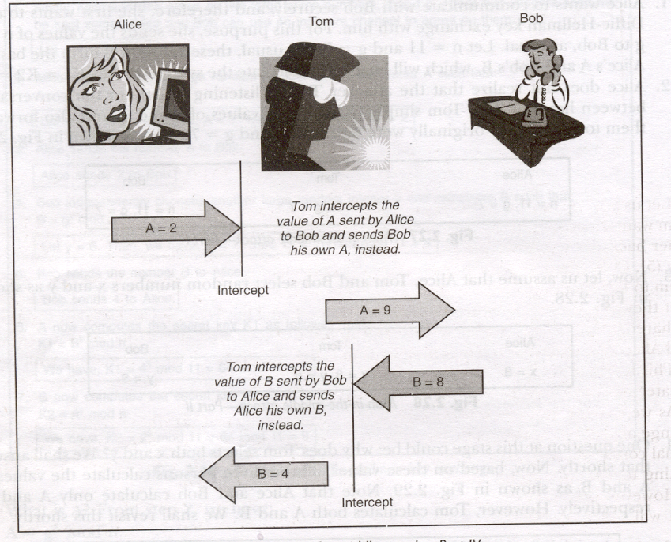
Man-in-the-middle Attack

Slide 8
Why Tom needs Two Keys??
At one side Tom wants to communicate with Alice securely using shared symmetric key (9), other side with Bob using a different shared symmetric key (5).
Only then he can receive messages from Alice, view/manipulate them & forward them to Bob & vice-versa.
Alice feels that key 9 is shared between her & Bob, whereas Bob feels that key 5 is shared between him & Alice.
Tom is sharing key 9 with Alice & 5 with Bob.
That’s why Tom needed both sets of the secret key variables x & y, and also non-secret variables A & B.
The man-in-the-middle attack can work against the Diffie-Hellman key exchange algorithm, causing it to fail.

Slide 9
An Alternative Emerges: Namely Asymmetric Key Operation

Slide 10
Problems with the Public Key Exchange
Throughout the discussion, we assume that Alice knows the value of public key of the Bob (sender), & Bob knows the value of public key of the Alice (receiver).
Alice can simply send her public key to Bob, and request for Bob’s Public key, in turn.
The man-in-the-middle attack can be launched by Tom.

Slide 11
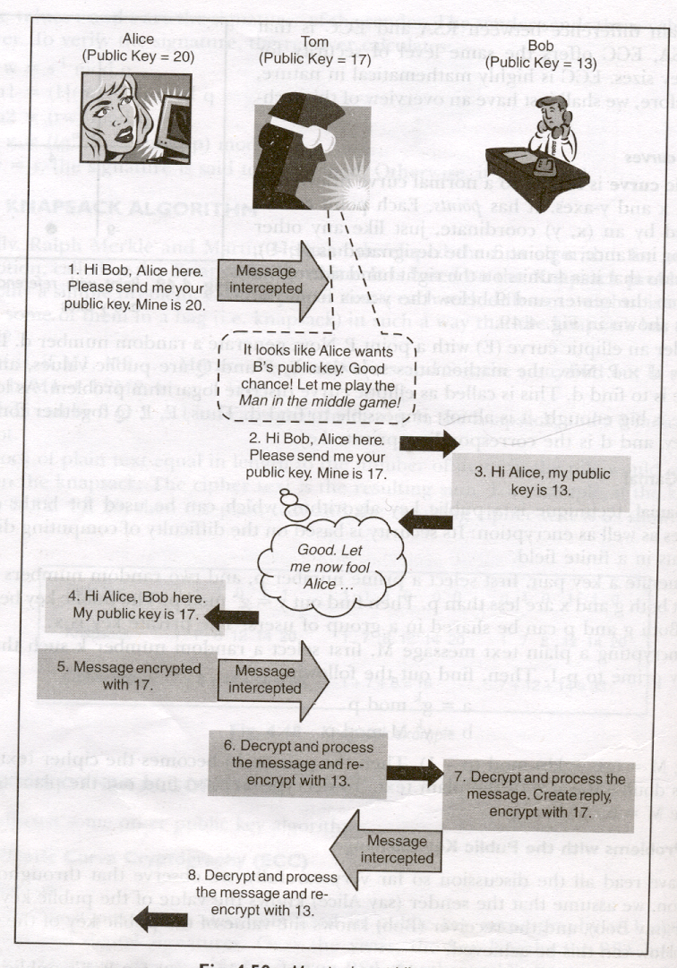
Man-in-the-middle Attack

Slide 12
Man-in-the-middle Attack
Public key values for the sender (Alice), attacker (Tom),& receiver
(Bob) are 20, 17,& 13 respectively.
When Alice wants to send a message securely to Bob, she sends her public key to Bob (20) & asks Bob for Bob’s public key.
Tom-the attacker-intercepts Alice’s message. He changes the public key value in Alice’s original message from 20 to his own 17 & forwards this message to Bob.
Bob sends back his public key (13) in response to Alice’s message.
Tom intercepts bob’s message, changes the public key to 17, & forwards it to Alice.
Alice thinks that Bob’s public key is 17. She encrypts the message with 17 & sends it to Bob.

Slide 13
Man-in-the-middle Attack
Tom intercepts this message, uses his private key to decrypt the message, processes it re-encrypts the message with Bob’s public key & forwards it to Bob.
Bob decrypts the message coming from Tom with his private key, depending on the message forms a reply. He encrypts the reply with Alice’s public key 17 (which is actually Tom’s Public key).
Tom intercepts Bob’s reply, uses his private key to decrypt the message, processes it, re-encrypts it with the real public key of Alice 20, and sends it to Alice. Alice can decrypt it with her private key.
This process can go on & on, without either Bob or Alice realizing
that an attacker is playing havoc!! This is especially truer if Tom
can perform the encryption & decryption really fast!!

Slide 14
Asymmetric Key Cryptography technique resolves the problem of key exchange, but it does not resolve the basic problem of making available the public keys of correspondents to each other.
“An Alternative Emerges: Namely Public Key Infrastructure PKI”

